Slide 1

Real-Time Rendering
Carl Jones
High Dynamic Range Lighting / Lighting Effects

Slide 2
Introduction
Real time glow effects are appearing in games
Add perception of brightness to objects
Glow results from light scattering due to interaction with particles in the atmosphere
Generally applied as a post processing effect

Slide 3
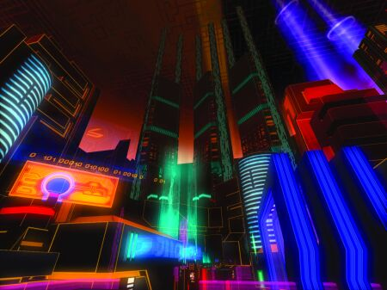
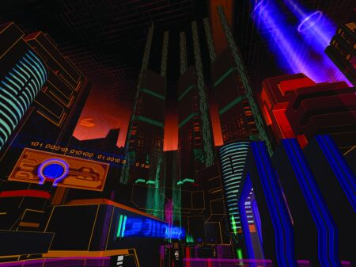
Full screen glow
A Tron 2.0 Cityscape from Greg James 2004

Slide 4

Render to a texture

Slide 5

Resized and blurred

Slide 6


Texture rendered onto scene

Slide 7
Glow
Render bright regions of the scene to an off-screen render target texture.
Down sample the render target texture to another smaller render target texture.
Horizontally blur the down sampled texture
vertically the horizontal blur
Render the small blurred glow on top of the full size rendered frame buffer

Slide 8

Rendering offscreen
//Glow
ID3D11Texture2D* m_renderTargetTexture;
ID3D11RenderTargetView* m_renderTargetView;
ID3D11ShaderResourceView* m_shaderResourceView;

Slide 9
D3D11_TEXTURE2D_DESC textureDesc;
D3D11_SHADER_RESOURCE_VIEW_DESC shaderResourceViewDesc;
// Initialize the render target texture description.
ZeroMemory(&textureDesc, sizeof(textureDesc));
// Setup the render target texture description.
textureDesc.Width = textureWidth;
textureDesc.Height = textureHeight;
textureDesc.MipLevels = 1;
textureDesc.ArraySize = 1;
textureDesc.Format = DXGI_FORMAT_R32G32B32A32_FLOAT;
textureDesc.SampleDesc.Count = 1;
textureDesc.Usage = D3D11_USAGE_DEFAULT;
textureDesc.BindFlags = D3D11_BIND_RENDER_TARGET | D3D11_BIND_SHADER_RESOURCE;
textureDesc.CPUAccessFlags = 0;
textureDesc.MiscFlags = 0;
// Create the render target texture.
result = md3dDevice->CreateTexture2D(&textureDesc, NULL, &m_renderTargetTexture);

Slide 10
D3D11_RENDER_TARGET_VIEW_DESC renderTargetViewDesc;
// Setup the description of the render target view.
renderTargetViewDesc.Format = textureDesc.Format;
renderTargetViewDesc.ViewDimension = D3D11_RTV_DIMENSION_TEXTURE2D;
renderTargetViewDesc.Texture2D.MipSlice = 0;
// Create the render target view.
result = md3dDevice->CreateRenderTargetView(m_renderTargetTexture, &renderTargetViewDesc, &m_renderTargetView);
// Setup the description of the shader resource view.
shaderResourceViewDesc.Format = textureDesc.Format;
shaderResourceViewDesc.ViewDimension = D3D11_SRV_DIMENSION_TEXTURE2D;
shaderResourceViewDesc.Texture2D.MostDetailedMip = 0;
shaderResourceViewDesc.Texture2D.MipLevels = 1;
// Create the shader resource view.
result = md3dDevice->CreateShaderResourceView(m_renderTargetTexture, &shaderResourceViewDesc, &m_shaderResourceView);

Slide 11
Simple Blur Shader (ATI Rendermonkey)
const float2 offsets[12] = {
-0.326212, -0.405805,
-0.840144, -0.073580,
-0.695914, 0.457137,
-0.203345, 0.620716,
0.962340, -0.194983,
0.473434, -0.480026,
0.519456, 0.767022,
0.185461, -0.893124,
0.507431, 0.064425,
0.896420, 0.412458,
-0.321940, -0.932615,
-0.791559, -0.597705,
};
float BlurScale;

Slide 12
Simple Blur Shader
float4 ApplyBlur(VS_OUTPUT inp) : COLOR
{
float4 sum = tex2D(SamplerState, inp.TexCoord); for(int i = 0; i &lt; 12; i++){
sum += tex2D(SamplerState, inp.TexCoord + BlurScale * offsets[ i ]);
}
sum /= 13;
sum.a = 1.0f;
return sum;
}

Slide 13

Horizontal Blur
float4 PS_Blur_Horizontal( VS_OUTPUT ps_in ) : COLOR
{
float kernelHalf=10.0;
float4 avgCol = 0;
int count = 0;
float dU=1.0/(texWidth*Kscale);
for (float stepU = -kernelHalf; stepU < kernelHalf; stepU++)
{
avgCol += tex2D(sampTexture, ps_in.texCoord + float2(dU * stepU, 0));
count += 1;
}
return (avgCol/count);
}

Slide 14

Vertical Blur
float4 PS_Blur_Vertical( VS_OUTPUT ps_in ) : COLOR
{
float kernelHalf=1.0;
float4 avgCol = 0;
int count = 0;
float dV=1.0/(texHeight*Kscale);
for (float stepV = -kernelHalf; stepV < kernelHalf; stepV++)
{
avgCol += tex2D(sampTexture, ps_in.texCoord + float2(0, dV * stepV);
count += 1;
}
return (avgCol / count);
}

Slide 15

Glow effects

Slide 16

Lens Effects

Slide 17


Star Burst
The shape is determined by the shutter shape.
The light entering the aperture is diffracted causing the characteristic starburst pattern
http://resources.mpi-inf.mpg.de/lensflareRendering/pdf/flare.pdf

Slide 18
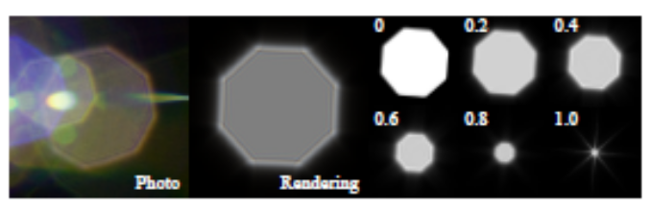
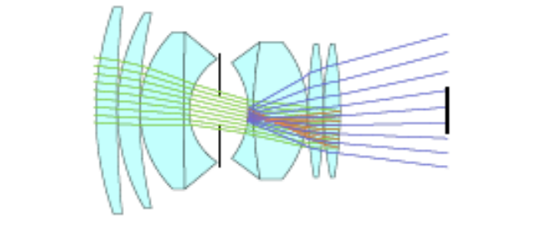
Lens Flare - Rings
The shape is determined by the shutter shape.
The number of Rings is determined the interface between components of the compound lens.
For white light the rings can be different colours as different frequencies of light bend differently
http://resources.mpi-inf.mpg.de/lensflareRendering/pdf/flare.pdf

Slide 19
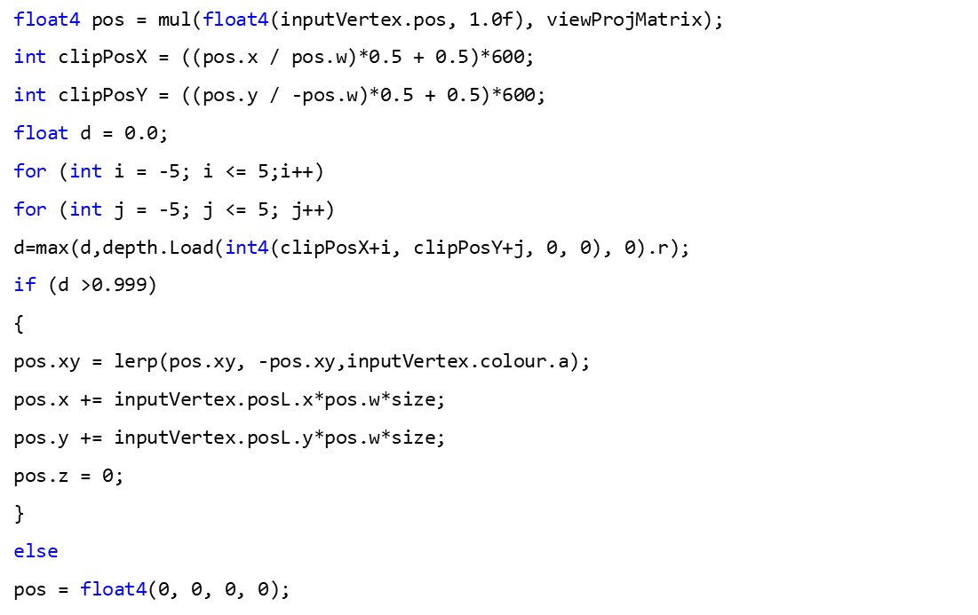
Vertex shader

Slide 20
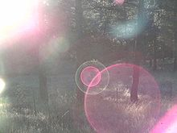
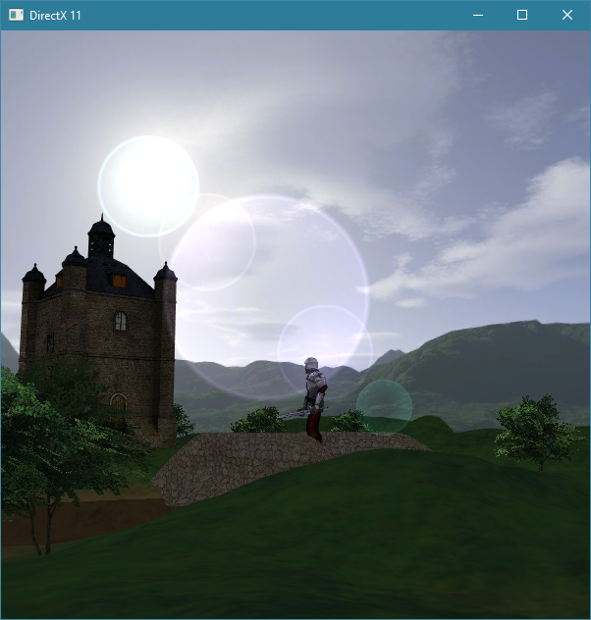

Slide 21
FURTHER READING
Introduction to 3D Game Programming with DirectX 9 (Frank D. Luna, Wordware Game and Graphics Library)
http://www.gamasutra.com/features/20040526/james_01.shtml
GPU GEMS
http://resources.mpi-inf.mpg.de/lensflareRendering/pdf/flare.pdf

